Slide 1
WATER INTAKE ANALYSIS
PRESENTED BY JOAN WAITHERA

Slide 2
Introduction
This project is one that reflects a part of my personal life that I hope to improve on
The great question is “Why I do not stick to the good habit of drinking water?” After reflection to find the root cause using the “Five Whys” I have understood that my motivations in are misconstrued
This is because my approach to anything health is “fix it” motivated rather than “prevent it”
With this in mind, I went ahead and conducted an analysis of a working week (27/05/2024 – 31/05/2024) which I had accurate data for.

Slide 3
Fields of data and Explanations
This report is linked to a google spreadsheet, LINK, where there are Two Sheets, Data Sheet and Pivot Table that further support this report
DATE: The correspondent dates of recording data
QUANTITY: This is a measurement in liters of the water taken
DURATION: The duration of time that I took taking the designated amount. Short or Long
INTAKE RATE: The mode of taking the water. Slow in sips or Quick in chugs
% OF TOTAL QUANTITY: This is the percentage of intake per entry as compared to the total quantity taken

Slide 4
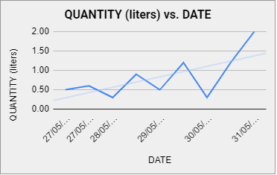
Findings First Finding
In my first finding, I have noticed that my water intake has increased gradually through the week. This ties to me being more intentional with the habit as I went by

Slide 5
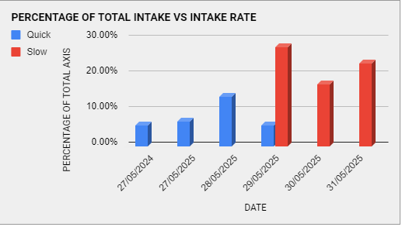
Second Finding
As I went through this journey I found that my rate of intake was a big factor. This meant if I sipped slow it felt more natural and less of a chore hence I took more water in the larger scheme of things and the vice versa is true. This is evident in the chart below

Slide 6
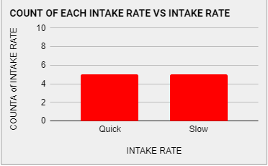
Final Finding
Lastly, there is the count of the Intake Rates to understand how I oscillate between the two; Slow in sips or Quick in chugs to understand any improvement after committing to the good habit. The two are equal ( 5,5 )

Slide 7

Conclusion
The Intake Rate greatly affects the attitude that I attach to this behavior. The less I make it feel like a chore the better the chances I have in drinking more water

